Slide 2
SQL11 – T-SQL Expert

Slide 3
Cursores
O que é um cursor?
Conjunto de registros nomeado na qual a posição corrente é mantida enquanto nos movimentamos pelos registros.
Uma tabela temporária que salva o resultado de uma consulta e possui um nome. O cursor está disponível para leitura, movimentação e outros usos, até que seja fechado.
Problemas relativos a cursores
Sai de um modelo relacional baseado em conjuntos (set based), aplicando lógica procedural.
Manipulação linha-a-linha tem overhead
Evita otimização do acesso a dados pelo otimizador
Tipicamente mais lentos que soluções set-based (embora haja cenários nos quais isto se inverte)

Slide 4
Evolução do programador
Evolução do programador T-SQL
Procedural: quando os programadores começam a trabalhar com o SQL Server, trazendo experiência de alguma linguagem de programação.
Ficando lúcido: a pessoa entende um pouco mais de programação orientada a conjuntos. Acreditam que tabelas temporárias, cursores e execução dinâmica são o mal da humanidade. ☺
Maturidade: já possui um conhecimento dos detalhes da arquitetura em que trabalha. Avalia prós e contras de cada abordagem, dando preferência a operações de conjuntos, porém sabendo reconhecer quando cursores, tabelas temporárias e execução dinâmicas são importantes.

Slide 5
Utilização básica de cursores
Declara o cursor
Abre o cursor para uso
Varre o cursor usando a instrução FETCH
Atualiza ou apaga a linha na tabela usando a posição atual do ponteiro (opcional e pouco usado)
Fecha o cursor
Libera (deallocate) o cursor para remover a sua referência
Notes:
SELECT * FROM [Order Details]
DECLARE @c1 int, @c2 int, @c3 money, @c4 smallint, @c5 real
DECLARE C CURSOR FOR SELECT * FROM [Order Details]
DECLARE @tabela TABLE (c1 int, c2 int, c3 money, c4 smallint, c5 real)
OPEN C
FETCH NEXT FROM C INTO @c1, @c2, @c3, @c4, @c5
WHILE @@FETCH_STATUS = 0
BEGIN
INSERT INTO @tabela VALUES (@c1, @c2, @c3, @c4, @c5)
FETCH NEXT FROM C INTO @c1, @c2, @c3, @c4, @c5
END
SELECT * FROM @tabela
CLOSE C
DEALLOCATE C
@@FETCH_STATUS:
1
The result set of the cursor has at least one row.
For insensitive and keyset cursors, the result set has at least one row.
For dynamic cursors, the result set can have zero, one, or more rows.
The cursor allocated to this variable is open.
For insensitive and keyset cursors, the result set has at least one row.
For dynamic cursors, the result set can have zero, one, or more rows.
0
The result set of the cursor is empty.*
The cursor allocated to this variable is open, but the result set is definitely empty.*
-1
The cursor is closed.
The cursor allocated to this variable is closed.
-2
No cursor was assigned to this OUTPUT variable by the previously called procedure.
A cursor was assigned to this OUTPUT variable by the previously called procedure, but it was in a closed state upon completion of the procedure. Therefore, the cursor is deallocated and not returned to the calling procedure.
There is no cursor assigned to a declared cursor variable.
-3
A cursor with the specified name does not exist.
A cursor variable with the specified name does not exist, or if one exists it has not yet had a cursor allocated to it.
SQL Server Books Online

Slide 6
Utilização básica de cursores
DECLARE variavel_cursor CURSOR FOR SELECT coluna1, coluna2 FROM ...
DECLARE @variavel1, @variavel2
OPEN variavel_cursor
FETCH NEXT FROM variavel_cursor INTO @variavel1, @variavel2
WHILE @@FETCH_STATUS <> 0
BEGIN
-- Usa @variavel1, @variavel2 em comandos
FETCH NEXT FROM variavel_cursor INTO @variavel1, @variavel2
END
CLOSE variavel_cursor
DEALLOCATE variavel_cursor
Notes:
DECLARE @Relatorio TABLE
(
nomeCategoria varchar(100),
codigoProduto int,
nomeProduto varchar(100)
)
DECLARE @nomeCategoria varchar(100), @codigoProduto int, @nomeProduto varchar(100)
DECLARE listaProdutos CURSOR FOR
SELECT C.CategoryName, P.ProductID, P.ProductName
FROM Products P INNER JOIN Categories C ON P.CategoryID = C.CategoryID
OPEN listaProdutos
FETCH NEXT FROM listaProdutos INTO @nomeCategoria, @codigoProduto, @nomeProduto
WHILE @@FETCH_STATUS = 0
BEGIN
INSERT INTO @Relatorio VALUES (@nomeCategoria, @codigoProduto, @nomeProduto)
FETCH NEXT FROM listaProdutos INTO @nomeCategoria, @codigoProduto, @nomeProduto
END
CLOSE listaProdutos
DEALLOCATE listaProdutos
SELECT * FROM @Relatorio

Slide 7
Tipos de Cursores T-SQL
Cursor STATIC
Uma foto dos dados é armazenada na tempdb.
Scrollable por padrão (diferente do INSENSITIVE)
Consulta com agregação pode causar materialização do cursor, convertendo-o para estático.
Não vê alterações nos registros originais
Cursor KEYSET
Cria listagem de chaves (índice único) na tempdb para registros que atendem a consulta.
Alterações dos registros originais são percebidas
Se linha for excluída: retorna NULL ou default e @@FETCH_STATUS = -2
Notes:
STATIC
Defines a cursor that makes a temporary copy of the data to be used by the cursor. All requests to the cursor are answered from this temporary table in tempdb; therefore, modifications made to base tables are not reflected in the data returned by fetches made to this cursor, and this cursor does not allow modifications.
KEYSET
Specifies that the membership and order of rows in the cursor are fixed when the cursor is opened. The set of keys that uniquely identify the rows is built into a table in tempdb known as the keyset.
Changes to nonkey values in the base tables, either made by the cursor owner or committed by other users, are visible as the owner scrolls around the cursor. Inserts made by other users are not visible (inserts cannot be made through a Transact-SQL server cursor). If a row is deleted, an attempt to fetch the row returns an @@FETCH_STATUS of -2. Updates of key values from outside the cursor resemble a delete of the old row followed by an insert of the new row. The row with the new values is not visible, and attempts to fetch the row with the old values return an @@FETCH_STATUS of -2. The new values are visible if the update is done through the cursor by specifying the WHERE CURRENT OF clause.
SQL Server Books Online

Slide 8
Tipos de Cursores T-SQL
Cursor DYNAMIC
Considere um SELECT para cada FETCH
Podem aparecer/sumir registros
FETCH ABSOLUTE não pode ser utilizado (RELATIVE sim)
Se usar ORDER BY, índice deve existir.
Cursor FORWARD-ONLY
Cursores dinâmicos ou keyset que aceitam somente FETCH NEXT.
Forward-only/read-only: fast forward cursor
Notes:
Dynamic
Defines a cursor that reflects all data changes made to the rows in its result set as you scroll around the cursor. The data values, order, and membership of the rows can change on each fetch. The ABSOLUTE fetch option is not supported with dynamic cursors.
Foward only
Specifies that the cursor can only be scrolled from the first to the last row. FETCH NEXT is the only supported fetch option. If FORWARD_ONLY is specified without the STATIC, KEYSET, or DYNAMIC keywords, the cursor operates as a DYNAMIC cursor. When neither FORWARD_ONLY nor SCROLL is specified, FORWARD_ONLY is the default, unless the keywords STATIC, KEYSET, or DYNAMIC are specified. STATIC, KEYSET, and DYNAMIC cursors default to SCROLL. Unlike database APIs such as ODBC and ADO, FORWARD_ONLY is supported with STATIC, KEYSET, and DYNAMIC Transact-SQL cursors.
If a DECLARE CURSOR using Transact-SQL syntax does not specify READ_ONLY, OPTIMISTIC, or SCROLL_LOCKS, the default is as follows:
* If the SELECT statement does not support updates (insufficient permissions, accessing remote tables that do not support updates, and so on), the cursor is READ_ONLY.
* STATIC and FAST_FORWARD cursors default to READ_ONLY.
* DYNAMIC and KEYSET cursors default to OPTIMISTIC.
SQL Server Books Online

Slide 9


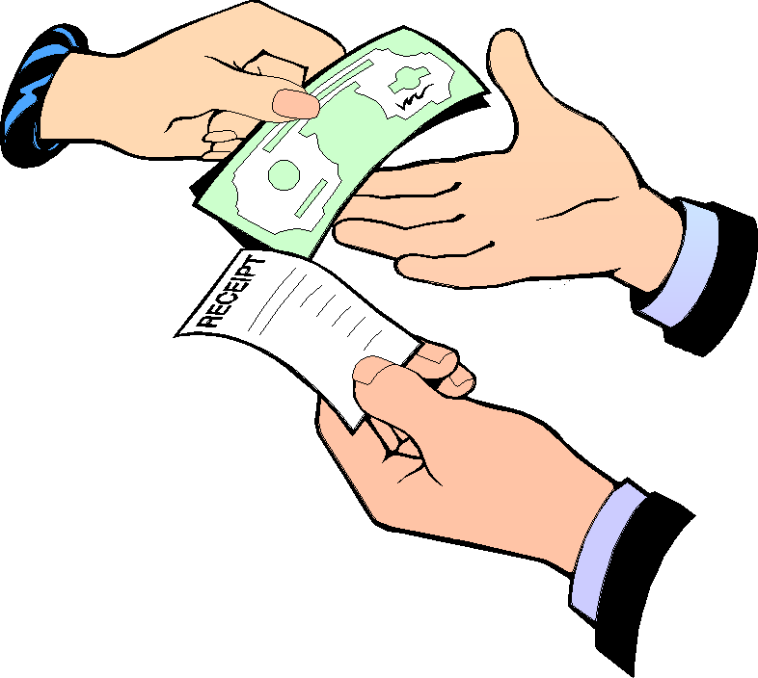
Window functions são baseadas em sets
*Analogy from Microsoft SQL Server 2008 Bible book
Notes:
SQL is often referred to as a set-based language. The reason is that the language is based on the relational model, which in turn is based, in part, on mathematical set theory. When writing SQL queries you’re supposed to deal with a table (or relation, which is a set) as a whole, as opposed to the table’s individual rows.
By Itzik Ben-Gan
http://www.sqlmag.com/blog/puzzled-by-t-sql-blog-15/tsql/window-functions-over-clause--help-make-a-difference-136840

Slide 10
Demo
Win32 app vs SQL Server
Notes:
Delphi vs SQL Server demo
DECLARE @i Int = 0
WHILE @i < 10000000 -- 10 million of iterations
BEGIN
SET @i += 1;
END
procedure TForm1.Button1Click(Sender: TObject);
Var
i : Int64;
Tempo : TDateTime;
begin
i := 0;
Tempo := Now();
while i <= 1000000000 do // On trillion of iterations
begin
inc(i);
end;
ShowMessage(FormatDateTime('hh:mm:ss.zzz', Tempo - Now()))
end;

Slide 11
O que são windows functions?
Funções aplicadas em um “conjunto de linhas”
Suportado no DB2, PostgreSQL, Oracle …
Funções analíticas e clausula Over() no SQL Server
SQL Server 2000
Sem suporte a windows funcitons
SQL Server 2005
Suporte em:
SQL Server 2008/R2
Nenhuma novidade em relação a windows functions
SQL Server 2012
Suporte em:
Clausula OVER (limitada)
Row_Number
Rank
NTile
Supore extendido na clausula Over
Lead, Lag
First_Value, Last_Value
Cume_Dist
Percent_Rank
Percentile_Disc
Percentile_Cont
Order By
Window Frame
Dense_Rank

Slide 12
Clausula OVER()
function + partition by + order by + window frame
SELECT ID_Account,
ColDate,
ColValue,
SUM(ColValue) OVER(PARTITION BY ID_Account
ORDER BY ColDate
RANGE UNBOUNDED PRECEDING) AS RunningTotal
FROM TestRunningTotals
ORDER BY ID_Account, ColDate
GO
PARTITION BY
ORDER BY
Default WINDOW FRAME

Slide 13
Suporte no SQL Server 2012
Suporte a cláusula OVER() melhorado
Order by
Partition By
Window frame
Novo pacote de funções:
LEAD(), LAG(), FISRT_VALUE(), LAST_VALUE(), CUME_DIST(), PERCENT_RANK(), PERCENTILE_CONT(), PERCENTILE_DISC()

Slide 14
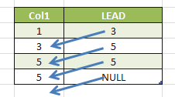
LEAD()
Retorna o valor da próxima linha no mesmo result set
SELECT Col1,
LEAD(Col1, 1) OVER(ORDER BY Col1) AS [LEAD]
FROM Tab1

Slide 15
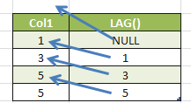
LAG()
Retorna o valor da linha anterior no result set
SELECT Col1,
LAG(Col1, 1) OVER(ORDER BY Col1) AS [LAG()]
FROM Tab1

Slide 16
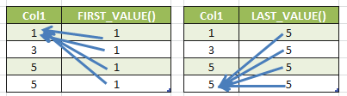
FIRST_VALUE() and LAST_VALUE()
SELECT Col1,
FIRST_VALUE(Col1) OVER(ORDER BY Col1) AS [FIRST_VALUE()]
FROM Tab1
SELECT Col1,
LAST_VALUE(Col1)
OVER(ORDER BY Col1
ROWS BETWEEN UNBOUNDED PRECEDING AND
UNBOUNDED FOLLOWING) AS [LAST_VALUE()]
FROM Tab1

Slide 17

Window Frame
[ROWS | RANGE] BETWEEN <Start expr> AND <End expr>
<Start expr> sendo:
UNBOUNDED PRECEDING: A window inicia na primeira linha da partição
CURRENT ROW: A window inicia na linha atual
<utilizando um inteiro literal> PRECEDING ou FOLLOWING
<End expr> sendo:
UNBOUNDED FOLLOWING: A window termina na última linha da partição
CURRENT ROW: A window termina na linha atual
< utilizando um inteiro literal> PRECEDING ou FOLLOWING

Slide 18
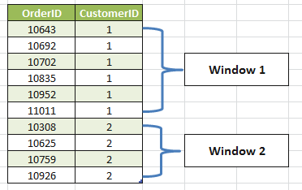
Window Frame – Duas windows…
USE NorthWind
GO
SELECT OrderID, CustomerID
FROM Orders
WHERE CustomerID IN (1,2)
ORDER BY CustomerID

Slide 19
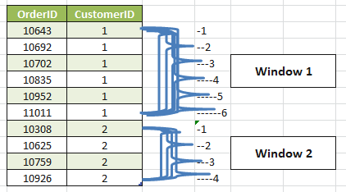
Window Frame – Windows coexistem

Slide 20
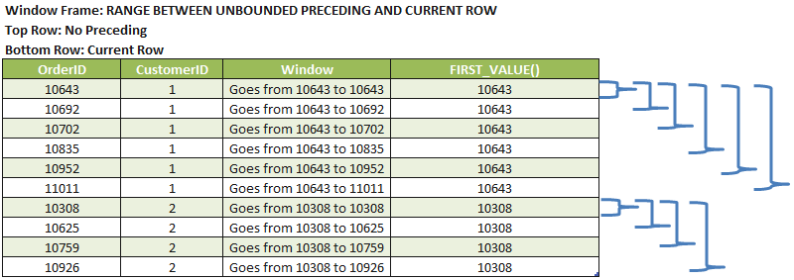
Exemplo Window Frame – First_Value
SELECT OrderID, CustomerID,
FIRST_VALUE(OrderID) OVER(PARTITION BY CustomerID
ORDER BY OrderID) AS FirstOrderID
FROM Orders
WHERE CustomerID IN (1,2)

Slide 21
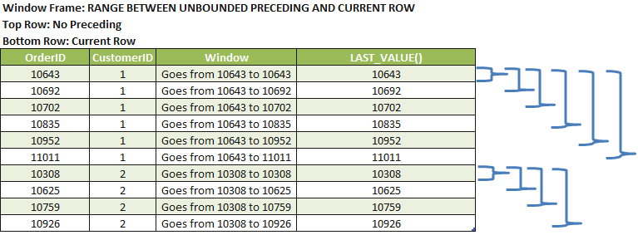
Exemplo Window Frame – Last_Value
SELECT OrderID, CustomerID,
LAST_VALUE(OrderID) OVER(PARTITION BY CustomerID
ORDER BY OrderID) AS FirstOrderID
FROM Orders
WHERE CustomerID IN (1,2)

Slide 22
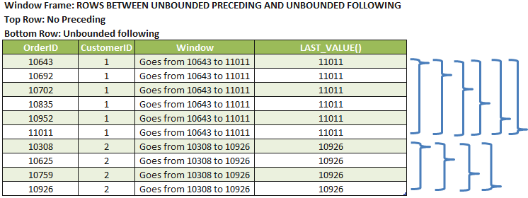
Exemplo Window Frame – Last_Value
…LAST_VALUE(OrderID)
OVER(PARTITION BY CustomerID
ORDER BY OrderID ROWS BETWEEN UNBOUNDED PRECEDING AND UNBOUNDED FOLLOWING) AS FirstOrderID ...

Slide 23
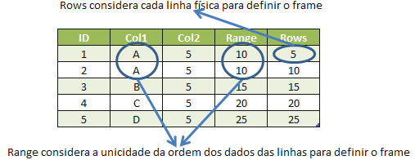
Window Frame – Diferença entre RANGE e ROWS
SELECT ID, Col1, Col2,
SUM(Col2) OVER(ORDER BY Col1 RANGE UNBOUNDED PRECEDING) "Range",
SUM(Col2) OVER(ORDER BY Col1 ROWS UNBOUNDED PRECEDING) "Rows"
FROM #TMP

Slide 24
O que ainda esta faltando:
Código Faltando:
FIRST, retorna o primeiro valor de um grupo ordenado MAX(Cidade) KEEP (DENSE_RANK FIRST ORDER BY SUM(Valor_Pedido))*
LAST: último valor de um grupo ordenado MIN(Cidade) KEEP (DENSE_RANK LAST ORDER BY SUM(Valor_Pedido))*
NULLs FIRST, NULLs LAST
OVER(ORDER BY Coluna1 NULLs FIRST)
Interval (Year, Month, Day, Hour, Minute, Second)
Window Clause
* Non standard syntax
SELECT LAG(Col1) OVER MyWin AS Col1 FROM Tab1
WINDOW MyWinAS (ORDER BY Col1 ROWS 2 PRECEDING)

Slide 26
Recursos
Artigos no Simple-talk:
http://tinyurl.com/SQLBits1
http://tinyurl.com/SQLBits2
http://tinyurl.com/SQLBits3
Livro do Itzik Ben-Gan (pre-order, May 2, 2012)
http://tinyurl.com/SQLBits4
Jeremiah Peschka YouTube video - Leaving the window open
http://tinyurl.com/SQLBits5

